Slide 1
AGRIRAIN AI
Agriculture Rainfall Prediction using Gradient Boosting
Machine Learning Project
T. Tejaswini | Roll No: 2520030510
Sree Haasini | Roll No: 2520030491
Eswakalipriya | Roll No: 2520030492
B . Tech – Computer Science Engineering

Slide 2
1. Project Overview
What AGRIRAIN AI does
AGRIRAIN AI is a web-based machine learning system for analysing historical agricultural and rainfall data.
It explores rainfall, crop, state, season, area, production, fertilizer and pesticide relationships.
The primary model is Gradient Boosting Regression for continuous crop-yield prediction.
The application also provides a Low / Medium / High yield classification and an interactive yield forecast simulator.
Goal: convert historical agricultural data into useful, explainable insights for crop planning and decision support.
AGRIRAIN AI • Agriculture Rainfall Prediction using Gradient Boosting 2

Slide 3
2. Problem Statement
Why this system is needed
Rainfall variability directly affects agricultural activity, but its effect differs across crops, states and seasons.
Large historical datasets contain useful patterns that are difficult to analyse manually.
Farm-oriented planning benefits from combining rainfall with production, area, fertilizer, pesticide, crop and location information.
Therefore, a data-driven system is required to analyse historical patterns and estimate crop yield from multiple factors.
AGRIRAIN AI addresses this through EDA, statistical relationships and Gradient Boosting based prediction.
AGRIRAIN AI • Agriculture Rainfall Prediction using Gradient Boosting 3

Slide 4
3. Objectives
Analyse historical rainfall and agricultural records across Indian states and crops.
Clean, validate and summarize the dataset before modelling.
Perform exploratory data analysis to identify crop, state, season and rainfall patterns.
Study correlations between rainfall, area, production, fertilizer, pesticide and yield.
Train and evaluate a Gradient Boosting model for yield prediction.
Provide an interactive web interface for analysis, model interpretation and yield simulation.
AGRIRAIN AI • Agriculture Rainfall Prediction using Gradient Boosting 4

Slide 5
4. Dataset Description
Actual dataset used in the uploaded project
Records
19,689
agricultural observations
Crops
55
crop categories
States
30
Indian states / regions
Seasons
6
season categories
Years
1997–2020
historical period
Columns: Crop, Crop_Year, Season, State, Area, Production, Annual_Rainfall, Fertilizer, Pesticide and Yield.
Categorical variables: Crop, Season and State. Numerical variables: Crop_Year, Area, Production, Annual_Rainfall, Fertilizer and Pesticide.
Yield is the primary target variable for the regression model.
AGRIRAIN AI • Agriculture Rainfall Prediction using Gradient Boosting 5

Slide 6
5. Data Preprocessing & Quality
Preparing the data for reliable analysis
CSV data is loaded using Pandas and required columns are validated.
Categorical values are stripped of unwanted leading/trailing spaces before analysis.
Dataset structure, missing values, duplicates, zero-yield and zero-production records are checked.
Categorical variables are encoded using OneHotEncoder with handle_unknown='ignore'.
Numerical variables are passed directly to the model.
The same preprocessing is placed inside a Scikit-learn Pipeline so training and prediction use consistent transformations.
AGRIRAIN AI • Agriculture Rainfall Prediction using Gradient Boosting 6

Slide 7
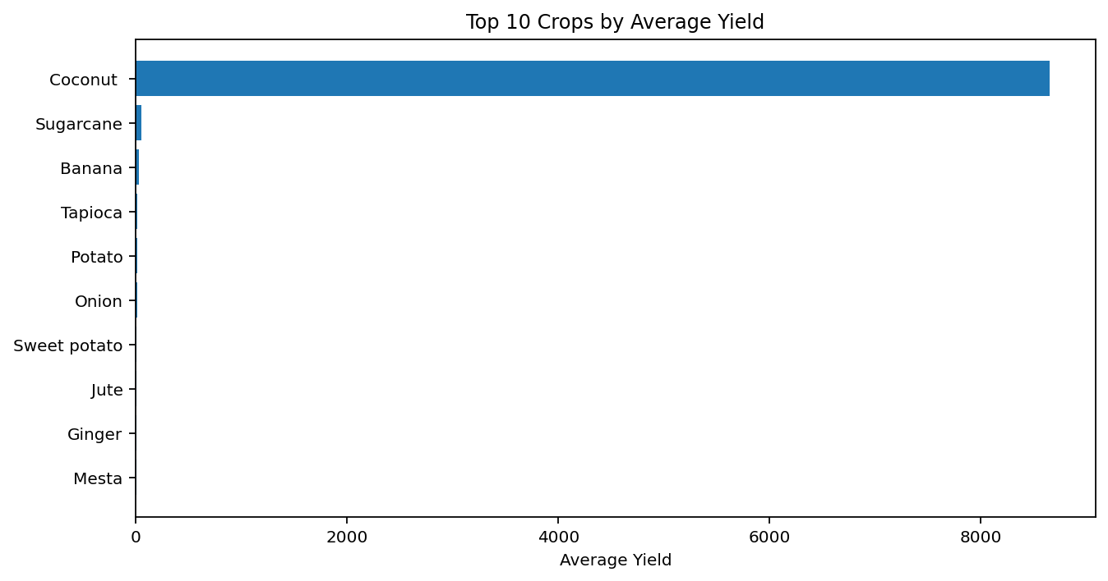
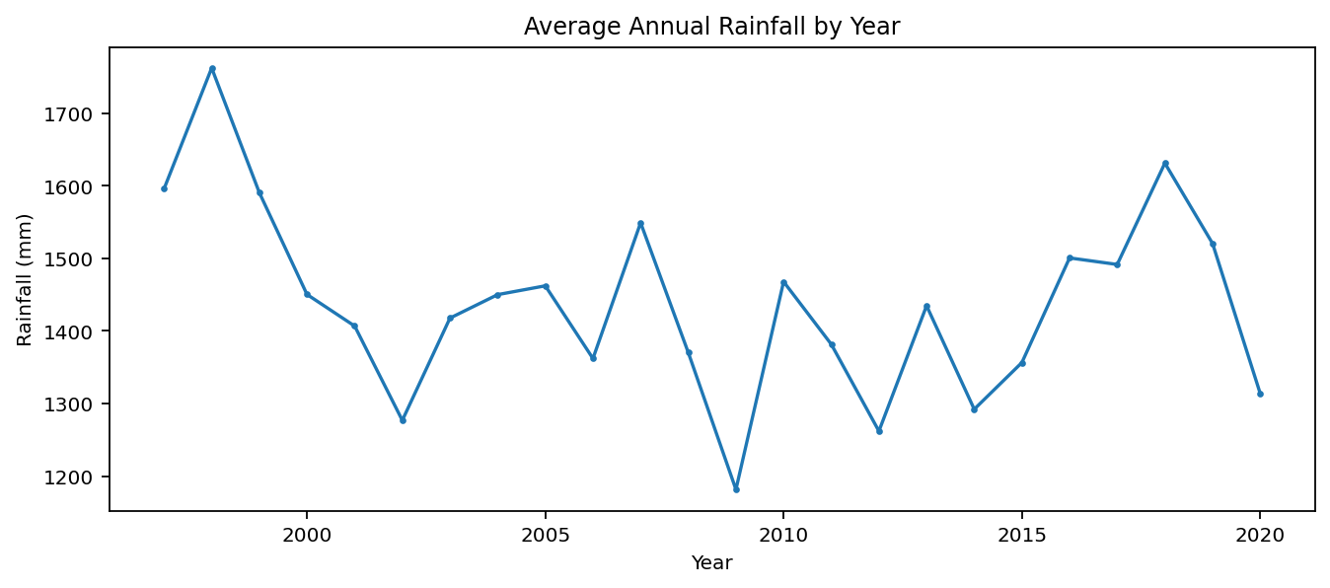
6. Exploratory Data Analysis (EDA)
Understanding the agricultural data before modelling
EDA modules: crop distribution • state distribution • season distribution • rainfall distribution • yield distribution • average yield • total production
AGRIRAIN AI • Agriculture Rainfall Prediction using Gradient Boosting 7

Slide 8
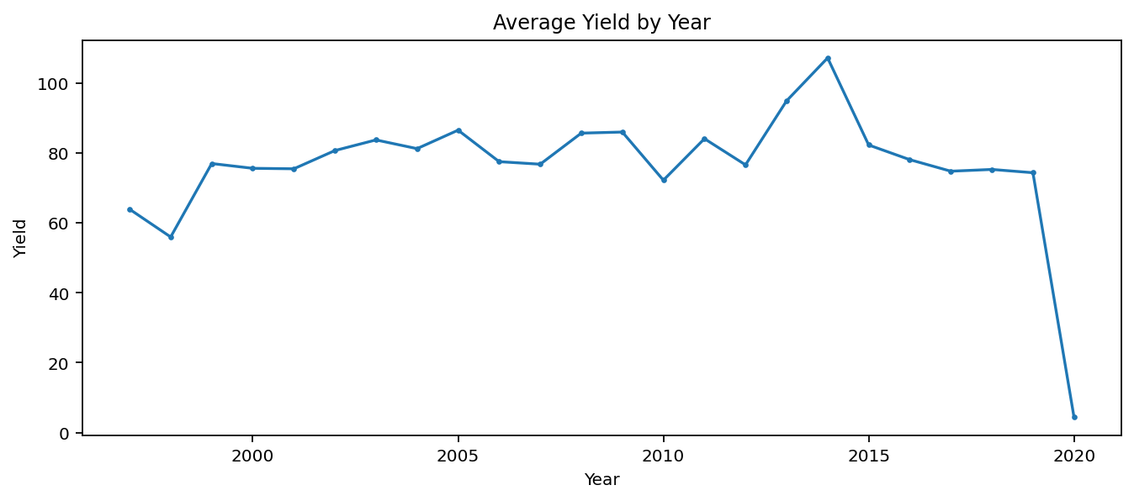
7. Time & Rainfall Analysis
Finding changes across the historical period
The application aggregates records by Crop_Year.
Average rainfall is tracked year-by-year and compared with average yield.
Total production, crop activity and seasonal yield trends can also be explored.
Trend slopes are calculated using a linear fit for descriptive analysis.
AGRIRAIN AI • Agriculture Rainfall Prediction using Gradient Boosting 8

Slide 9
8. Relationship Analysis
Rainfall is only one part of the yield story
Pearson correlation is used to measure linear relationships.
Spearman correlation is also calculated because agricultural data contains outliers and non-linear patterns.
Scatter plots compare Annual_Rainfall, Area, Production, Fertilizer and Pesticide with Yield.
An important modelling insight is that rainfall alone is not sufficient to explain yield across all crops.
Crop type, geography, production scale and agricultural inputs must be considered together.
Correlation is interpreted as association, not proof of causation.
AGRIRAIN AI • Agriculture Rainfall Prediction using Gradient Boosting 9

Slide 10
9. Proposed System Architecture
End-to-end workflow
1
CSV Dataset
2
Data Validation
3
EDA & Statistics
4
Feature Encoding
5
Gradient Boosting
6
Evaluation
7
Web Forecast
Backend: Flask routes orchestrate data loading, analytics and model prediction.
Analysis: Pandas + NumPy. Machine learning: Scikit-learn. Frontend charts: Plotly JavaScript.
Model is cached after training so repeated page requests do not retrain it.
AGRIRAIN AI • Agriculture Rainfall Prediction using Gradient Boosting 10

Slide 11
10. Gradient Boosting Model
Primary machine learning approach
Gradient Boosting Regression is used because it can model complex non-linear relationships and interactions.
200 boosting estimators are trained with learning_rate = 0.1.
Maximum tree depth = 4 and subsample = 0.8 are used to balance learning and generalization.
80% of records are used for training and 20% for testing; random_state = 42 ensures reproducibility.
Categorical features are one-hot encoded before entering the Gradient Boosting regressor.
Target: continuous Yield.
Estimators
200
Gradient Boosting trees
Train / Test
80 / 20
data split
Learning Rate
0.10
model parameter
AGRIRAIN AI • Agriculture Rainfall Prediction using Gradient Boosting 11

Slide 12
11. Model Performance
Results from the implemented regression model
R² SCORE
0.9862
variance explained on test set
RMSE
105.33
root mean squared error
MAE
8.39
mean absolute error
Training records: 15,751. Test records: 3,938.
R² close to 1 indicates very strong predictive fit on this dataset.
RMSE is more sensitive to large prediction errors, while MAE gives the average absolute deviation.
These metrics describe performance on the held-out test set and should be interpreted in the context of the dataset and target definition.
AGRIRAIN AI • Agriculture Rainfall Prediction using Gradient Boosting 12

Slide 13
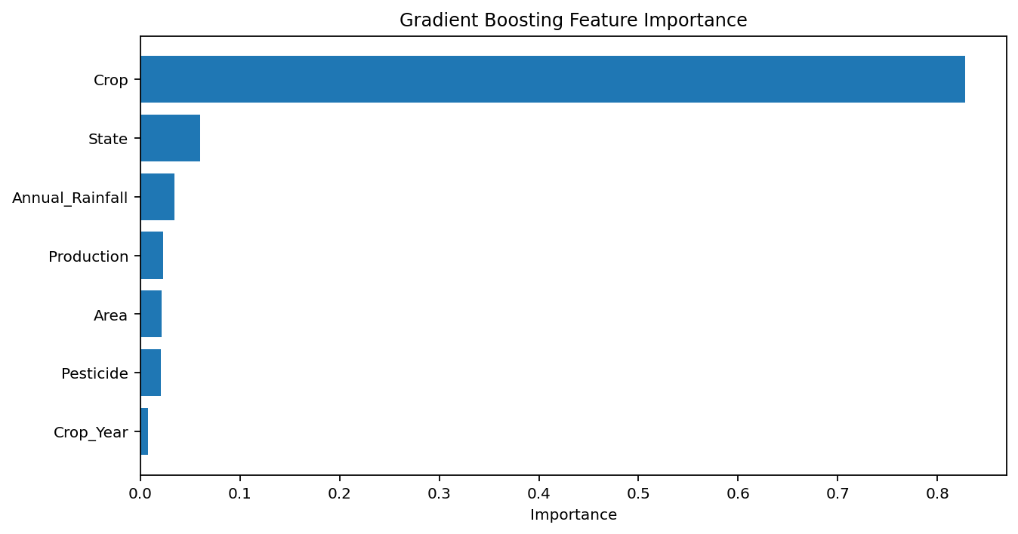
12. Feature Importance
Which inputs contribute most to the model?
Feature importance is extracted directly from the trained Gradient Boosting model.
Categorical one-hot features are aggregated back to their original variables for easier interpretation.
Top grouped feature: Crop (0.828).
Importance indicates contribution to the model's split-based prediction process; it does not prove causation.
AGRIRAIN AI • Agriculture Rainfall Prediction using Gradient Boosting 13

Slide 14
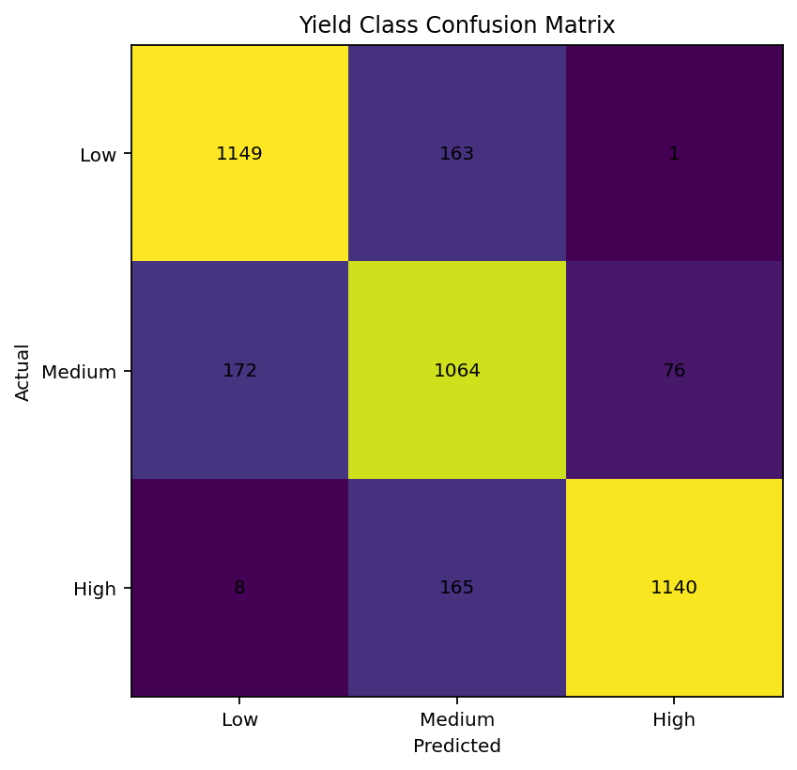
13. Supplementary Yield Classification
Low / Medium / High yield categories
ACCURACY
0.851
MACRO F1
0.853
Yield is divided into three classes using the 33rd and 67th percentiles.
Labels: Low, Medium and High.
A separate Gradient Boosting Classifier is trained using the same feature pipeline.
The confusion matrix shows how correctly the three yield categories are separated.
AGRIRAIN AI • Agriculture Rainfall Prediction using Gradient Boosting 14

Slide 15
14. Web Application Modules
What the user can do in AGRIRAIN AI
Overview
Dataset summary, key statistics and high-level charts.
Data Quality
Missing values, duplicates, data types and completeness.
EDA
Crop, state, season, rainfall, yield and production analysis.
Time Analysis
Year-wise rainfall, yield, production and seasonal trends.
Relationships
Correlation heatmap and variable-vs-yield scatter plots.
Gradient Boosting
Metrics, actual-vs-predicted plot, residuals and feature importance.
Forecast
Interactive yield prediction using user-selected agricultural inputs.
Findings
Conclusions and insights derived from data and model.
AGRIRAIN AI • Agriculture Rainfall Prediction using Gradient Boosting 15

Slide 16
15. Forecast Simulator
From analysis to an interactive prediction
User selects State, Crop and Season from valid dataset categories.
User enters Crop Year, Area, Production, Annual Rainfall, Fertilizer and Pesticide values.
The same trained preprocessing + Gradient Boosting pipeline receives the input.
The system returns a predicted continuous Yield value.
Input validation prevents invalid categories and values outside the dataset's supported year range.
This module demonstrates how the trained model can be used as a decision-support interface.
OUTPUT
Predicted Yield
generated by trained Gradient Boosting model
AGRIRAIN AI • Agriculture Rainfall Prediction using Gradient Boosting 16

Slide 17
16. Technology Stack
Python
Core programming, data processing and ML
Flask
Backend web framework and routing
Pandas
CSV loading, cleaning, grouping and statistics
NumPy
Numerical calculations and trend analysis
Scikit-learn
Preprocessing, Gradient Boosting and evaluation
Plotly.js
Interactive charts in the browser
HTML / CSS
Web page structure and styling
JavaScript
Interactive chart rendering and UI behaviour
AGRIRAIN AI • Agriculture Rainfall Prediction using Gradient Boosting 17

Slide 18
17. Key Findings & Limitations
Rainfall patterns vary considerably over the historical period and across states.
Yield is influenced by multiple agricultural variables; rainfall should not be treated as the only predictor.
Gradient Boosting captures non-linear relationships and provides strong predictive performance on the held-out dataset.
The web application makes the analysis accessible through visual dashboards and an interactive forecast form.
Limitation: yield units and agricultural measurement scales can differ across crops, so cross-crop comparisons require care.
Limitation: historical relationships do not guarantee future performance under climate or farming conditions not represented in the dataset.
AGRIRAIN AI • Agriculture Rainfall Prediction using Gradient Boosting 18

Slide 19
Conclusion
AGRIRAIN AI combines agricultural data analysis with machine learning to support yield-oriented decision making.
The system integrates data quality checks, EDA, trend analysis, correlation analysis, Gradient Boosting and interactive prediction.
The project demonstrates a complete pipeline from raw CSV data to a working web-based ML application.
Thank You • Questions & Viva

